Slide 1
EN.525.670.81.SP21 - Machine Learning for Signal Processing
Machine Learning for Satellite Tracking
Team Members : Alec Briley, Christian Mielke, Michael Palasits
Date: April 27, 2021

Slide 2
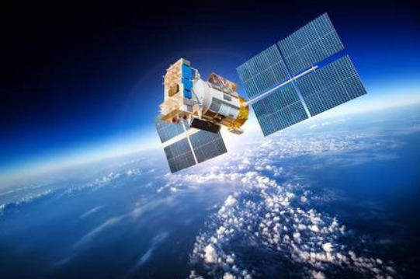

Overview
Introduction – Slides 3 - 4
Objective – Slide 5
Tasks – Slides 9 - 11
Results – Slides 12 - 13
Conclusions – Slide 14
Summary – Slide 15
Notes:
Image source: Google Image - https://encrypted-tbn0.gstatic.com/images?q=tbn:ANd9GcS5ABCCCgtUuacq6VBtNyXIYT7AIjxSCch3XA&usqp=CAU

Slide 3
Introduction
Satellite tracking currently uses a physics based approach to estimate orbits.
The physics based approach is known to have built in errors due to perturbations such as unpredictable atmospheric conditions and drag for Low Earth Orbit (LEO) satellites.
These errors can be large enough to cause collisions in the (LEO) environment.
Proposed solution: Use Machine Learning to model the orbit rather than a physics based approach to produce more accurate predictions based on satellite tracking errors.

Slide 4
Introduction – cont.
Briefly state what has been accomplished in this project.
Proper Model Implementation of Simplified General Perturbations (SGP4) propagator model for physics based approach and Truth Data obtained from ILRS
Proper implementation of supervised Support Vector Machine (SVM) Machine Learning approach to estimate future orbits with increased orbital prediction when compared to SGP4

Slide 5
Objective
Two Models will be formed for satellite orbital predictions:
Physics Propagation Model Approach: SGP4
Machine Learning Approach: will be used to model satellite orbits using SVM approach
ML approach will be compared to Physics based SGP4 approach to determine which approach is more accurate by calculating orbital errors based on truth data obtained from the International Laser Ranging Service (ILRS).
The same Two Line Element (TLE) data obtained from a LEO satellite will be inputted to both the SGP4 and our SVM model to predict the satellites orbital position
ML Objective: Develop a ML model that increases the accuracy of predicting orbital positions when compared to a physics based SGP4 approach. Our
ML SVM approach will determine orbital errors caused by perturbations through learning historical TLE data.

Slide 6
Tasks
Technical approach and Goals in order to accomplish the Project Objective
Sensor
Goal: Obtain orbital data needed to build a satellites position from orbital mechanics equations.
Technical Approach: Obtain 6 months of Training Data and 1 Month test data for training the Machine Learning Algorithm.
Signal Capture
Goal: Capture data with Keplerain elements necessary to create the Orbital Prediction model
Technical Approach: Extract both physics propagated data and truth data to compare with Machine Learning propagation model

Slide 7
Tasks – Cnt.
Data Conditioning
Goal: Time align input data with truth data for accurate error estimates of ML, SGP4, and Truth Data orbital satellite position comparisons
Technical Approach: Oversample the truth data via interpolation and extract data points from the truth data that closely matches input data.
Feature Extraction
Goal: Extract the 6 necessary Keplerian elements to predict an orbit of a LEO satellite
Technical Approach: Obtain data from data conditioning to ensure truth data and input data (i.e. Epoch) are in similar units for Modeling/Prediction phase.

Slide 8
Tasks – Cnt.
Modeling/Prediction
Goal: Determine orbital errors caused by perturbations of LEO satellites to increase the accuracy of satellite position predictions.
Technical Approach: Use supervised SVM ML approach to predict future orbital position. Determine pososisiton errors obtained by both SVM ML approach and SGP4 physics based approach when compared to ILRS truth data.

Slide 9
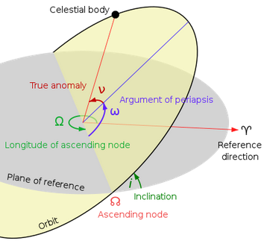
Sensor – TLE Data
The data to be used for the machine learning approach will be in the Two-Line Element (TLE) format.
TLE is a two-line text containing orbital information of an earth bodied satellite noted at a give time (“Epoch”)
This format includes the following Keplerian element information Epoch
Orbit inclination (deg.)
Right ascension of the ascending node (deg.)
Eccentricity
Argument of perigee (deg.)
Mean anomaly (deg.)
Mean motion (rev./day)
Revolution number at epoch (rev.)
Keplerian Elements for Orbital Predictions
Notes:
Picture taken from https://en.wikipedia.org/wiki/Orbital_elements

Slide 10
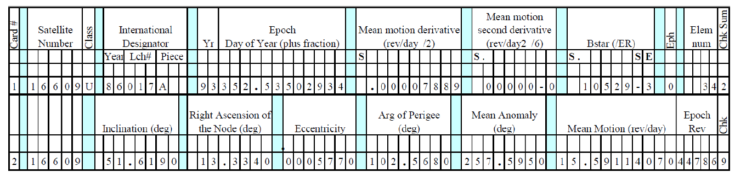
Sensor – TLE Data (Cnt.)
TLE data elements are in the following format and the data will have to be extracted via an automated script and converted for use into SGP4 model
Composition of TLE Data
Notes:
Picture taken from https://en.wikipedia.org/wiki/Orbital_elements

Slide 11
Sensor – Truth Data
The data to be used for the truth data will be in a modified version of Earth-centered, Earth-fixed (ECEF) format.
Modified Julian Day
Rectangular position characteristics (XYZ)
The data to be used for the SPG4 and SVM ML model will be in True Equator Mean Equinox (TEME) of Epoch Coordinate System format, based on the epoch of specified TLE.
Transformations from TEME to ECEF can be done by rotating X_{TEME} towards X_{ECEF} and Rotating instantaneous pole of TEME towards International Reference Pole (IRP) of ECEF.

Slide 12
Signal Capture
TLE data is acquired from US Strategic Command database and truth data is acquired from ILRS database.
The satellite Ajisai is used in this project due to the availability of truth data being limited to a smaller range of satellites than the TLE data.
Training data to be used in the machine learning algorithm is acquired in a six month block while test data is in a one month block

Slide 13
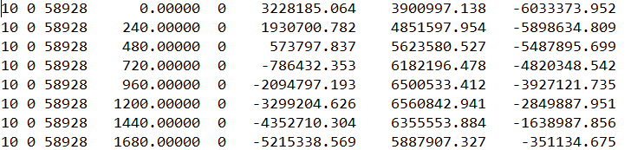
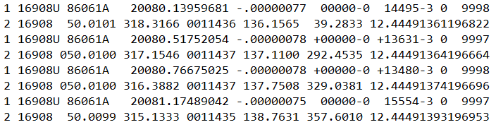
Results- Make each of these its own slide
Results obtained for each task in the ML paradigm:
Sensor and Signal Capture: Was able to successfully obtain TLE Input (Celestrak) and TLE Truth Data (ILRS) from online sources
Data Conditioning: Ran into issue of the TLE truth data being sampled at 1 sample/240 seconds, for a total of 360 points per day. The TLE input data only collected 3 samples per day at random time intervals.
Composition of ILRS Truth Data
Composition of TLE Input Data
Notes:
This is the main focus of the presentation. Positive or negative results should be presented with the details so that the reviewers will understand why the project is successful or runs into challenges.
Note: Plots and graphs are encouraged to use. However, do not just cut-and-paste the matlab output to presentation as is. The axis labels can be “enhanced” in the PowerPoint to help the reviewers to view the results.

Slide 14
Results – Cnt.
Feature Extraction
Successfully extracted the six necessary 1-D keplerian elements to model orbit from TLE data with sample times as close to the truth data as possible. Features of interest are Orbit Inclination, Right ascension of ascending node, Eccentricity, Argument of Perigee, Mean anomaly, Mean Motion, and Revolution number at Epoch
SVM Modeling/Prediction: (Enter Info/Include final plots)
Inputted TLE data and ILRS TLE data were passed through SGP4 model to calculate orbital state vectors of position in the X,Y,Z frame of reference based on their time (epoch)
SVM approach used to determine perturbations errors from supervised learning of historical data.
(Enter 3D orbital picture of SVM approach overlapping with truth data orbital trajectory)

Slide 15
Conclusions
Based on the results of each task, you conclude whether the project objective has been accomplished.
Lessons Learned and Recommendations
When signal capturing (TLE) data, it’s better to get data that’s sampled similar, and ideally consistent, rates
Recommend getting TLE data that’s sampled as frequently as truth data to avoid aliasing when trying to interpolate.
This section is where the team convinces the reviewers that the project is well done, regardless the positive or the negative results.
The accomplishment of the project will be assessed in terms of the details of the task execution and the result analysis, the understanding of the challenges encountered during the project execution, the conclusion drawn from the results, and the plan for further studies in the area of the proposed project.

Slide 16
Summary
Accomplishments and Findings
Successful implementation of Signal Capturing and Data Conditioning to implement TLE data to model a LEO satellite.
Successful implementation of Feature Extraction to get inputted TLE data to a 1-to-1 match with ILRS truth data.
Successful implementation of Machine Learning Objective of implementing SVM Machine Learning model to increase orbital prediction accuracy when compared to SGP4 physics based model.
Notes:
Summarize the accomplishments of the course project and highlight the findings of the projects.

